Slide 1
Introduction to Deep Learning Models in GIS
RCC Workshop
Parmanand Sinha, PhD
Computational Scientist

Slide 2
Introduction to deep learning
Artificial intelligence (AI) includes machine learning and deep learning, and each has an increasing level of complexity and system autonomy.
In this course, we will focus on deep learning, which is the most complex and humanlike approach that is currently used in AI. Deep learning uses neural networks to analyze data in a way that mimics the way a human brain processes information.

Slide 3
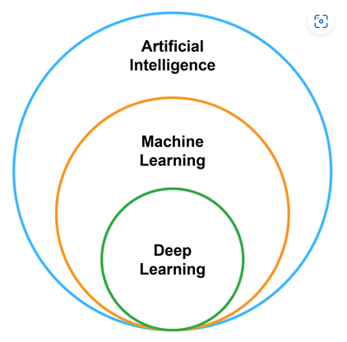
Deep learning is the most complex and autonomous subtype of artificial intelligence.

Slide 4
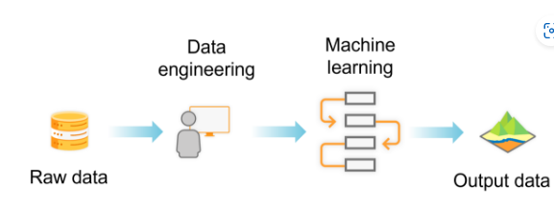
In machine learning, a human provides input and feedback to train an effective model.

Slide 5
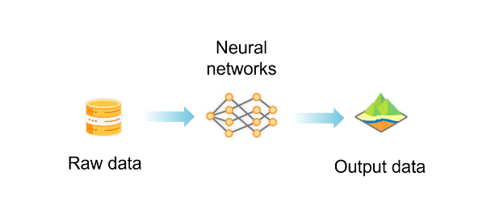
In deep learning, neural networks decide which data to use for the analysis, removing the need for manual input.

Slide 6
Deep learning in GIS
Deep learning models used in GIS employ a specific type of neural network called the convolutional neural network.
This type of neural network is designed for analyzing raster images and interpreting their content, which is known as computer vision.
Deep learning tasks that work well in GIS can be categorized into four types: image classification, object detection, semantic segmentation, and instance segmentation.

Slide 7
Object Classification
Models: FeatureClassifier with ResNet, Inception, VGG backbones
https://storymaps.arcgis.com/stories/0860894aa2b5442ca27b85c8f7915ce9

Slide 8
Object detection
Object detection involves locating specific features within an image. In this image, object detection is used in GIS to detect all the swimming pools in a neighborhood and then plot them on a map.

Slide 9
Semantic segmentation
Semantic segmentation involves classifying each pixel in an image. In GIS, semantic segmentation is often used to create land-cover types or land-use classification maps. In this image, each pixel is given a color based on the land-use type that has been assigned to it.

Slide 10
Instance segmentation
Instance segmentation is a more precise version of object detection. Instance segmentation can be used in GIS to detect objects from imagery and create a detailed dataset of those objects. In this image, instance segmentation created a polygon dataset of building footprints that were extracted from the imagery.

Slide 11
1. Prepare training data
2. Train the model
3. Run the model
4. Review and validate results

Slide 12
Pretrained deep learning models
The process of training a deep learning model can be time-consuming and requires robust computer processing resources.
Each pretrained model available in ArcGIS Living Atlas of the World has key metadata information on its item page. The information provided on the item page tells you what the model is doing and under what conditions it should be used. Because each pretrained model is developed for a specific task and trained on specific data, it is important to examine the item page to ensure that the model is appropriate for your situation.

Slide 13
https://doc.arcgis.com/en/pretrained-models/latest/get-started/intro.htm
Key item details
Item detail | Information
Title | Descriptive name of the model
Description | The goal of the model, the data involved, and why you might use the model
Licensing Requirements | Minimum ArcGIS software requirements to run the model
Input | Input data requirements, such as type and resolution
Output | Output data type, such as a polygon feature class
Applicable Geographies | Geographic region where the model can be expected to perform well
Key item details
Item detail | Information
Title | Descriptive name of the model
Description | The goal of the model, the data involved, and why you might use the model
Licensing Requirements | Minimum ArcGIS software requirements to run the model
Input | Input data requirements, such as type and resolution
Output | Output data type, such as a polygon feature class
Applicable Geographies | Geographic region where the model can be expected to perform well

Slide 14
Discover available pretrained models
In this exercise, you will navigate to ArcGIS Living Atlas of the World and search for a specific model. After examining the model details, you will explore some of the other available models.
Search for a deep learning model in ArcGIS Living Atlas
In a web browser, go to the ArcGIS Living Atlas of the World home page.
Near the top of the page, in the search bar, type deep learning and press Enter.

Slide 15
Notice that the pretrained models are published by esri_analytics as a Deep Learning Package item, as shown in the following graphic.
From the list filter options, check the box for Esri-Only Content, as shown in the following graphic.
In the search bar, after deep learning, type wind turbine and press Enter.

Slide 16
Discover additional pretrained models
From the ArcGIS Living Atlas home page, search for all deep learning model packages published by Esri.
Which model is an example of a semantic segmentation deep learning task?
What are some of the different data types that can be analyzed with the available pretrained models?

Slide 17
https://github.com/Esri/arcgis-python-api
https://github.com/Esri/arcgis-python-api/releases/download/v2.0.1/samples.zip

